Slide 1
Protecting Drinking Water via Pesticide Registration in New York
Lake Intakes Pilot
for DEC Bureau of Pest Management
Cooperating with FOLA members and
DEC Division of Water
May 2, 2015
Steve Pacenka
Soil & Water Group
Department of Biological & Environmental Engineering
Notes:
1
1
1
Thanks for inviting us to participate in this session.
I’m Steve Pacenka, a long time staff member at Cornell University’s College of Agriculture and Life Sciences. It has been my privilege to work alongside DEC staff to investigate pesticides in water since 1980.
Today I represent a part of New York’s pesticide regulation system in which the State monitors water to make sure that its rules about pesticide use do not lead to the escape of too many pesticide residues away from the areas where they are applied.
These rules include whether or not a particular chemical is allowed at all, and how much can be used where and at what times. This is under the jurisdiction of the DEC’s Division of Materials Management, Bureau of Pest Management.
Today I officially speak for myself since I am not a DEC employee; I’m an outside insider of the Bureau of Pest Management who pay most of my salary via contract. However when I say “we” I am referring to the project team across Cornell, two DEC divisions, and certain Lake Association volunteers. I did not have the sampling results to prepare this presentation until Wednesday, so I apologize in advance for not circulating a draft to the whole team before it is given in public.

Slide 2
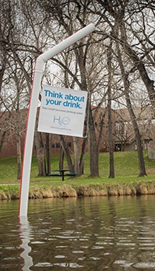
Geneva Lake,
Littleton Colorado
Notes:
Can we start with some questions?
====
So this is the Federation of Lake Associations annual celebration. How many of you actually live within five miles from a lake or reservoir?
How many get your home drinking water from that lake or reservoir?
How many of you get your drinking water from your own pipe into that lake, or your own shoreline well?
I first saw this kind of water supply at Skaneateles Lake where several hundred waterfront properties dip a pipe into the lake.
A friend in the State Health Department said “make sure you don’t encourage this.” The DOH considers this a very vulnerable way to get drinking water. Cities who take water from lakes are reservoirs are almost all required to filter the water and all must disinfect it. This is because of waterborne diseases like giardiasis.
It was because of this vulnerability that DEC and Cornell approached lake association volunteers about taking samples to test for pesticides from parts of lakes like those where some people dip in their straws. In the prior fifteen years we have been testing upstate private water wells, which have shown very few pesticide residues at levels of concern. Most private wells are better protected than lake intakes.

Slide 3
Outline
Brief background about pesticide use and control
Four-lake pilot test
Pesticides tested for
Results
Premature interpretations

Slide 4
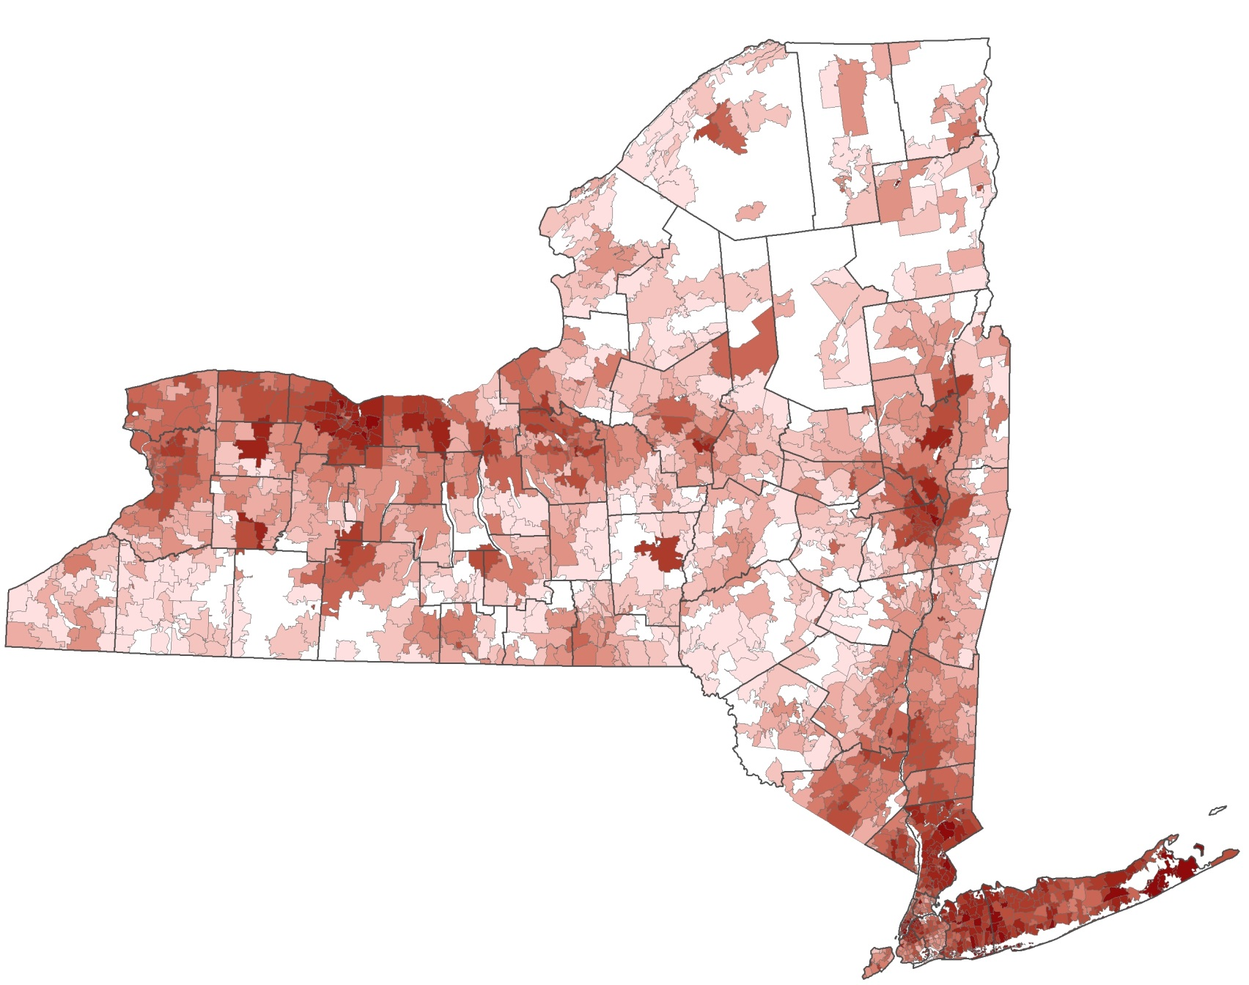
Pesticides used broadly, intensely in places
Notes:
The map shows darkest where there is the highest pesticide use, in terms of active ingredients per unit of land area. Such as pounds per acre. An active ingredient is that part of a pesticide product that does the dirty work.
This adds two categories of data from the State Pesticide Sales and Use Reporting system (PSUR) which covers restricted chemicals, not over-the-counter retail stuff that you get in a bag of “weed and feed”. (Some chemicals have both restricted and unrestricted packaging.) First is reported use amounts and types by commercial users, excluding farmers who treat their own land. Second is reported sales by retailers who sell to self-applying farmers. The second type can be fuzzy geographically if the seller to a farmer reports the seller’s zip code.
The main meanings of this map are that pesticides are used very widely and that there are both agricultural and urban high-intensity uses. Quite heavy in Long Island, New York City, Westchester, Rochester, and the farm belt south of Lake Ontario.

Slide 5
Control of pesticide use
Notes:
Pesticides are designed to destroy or at least to interfere with living things. They are spread deliberately in the open environment or inside buildings where people work and live to get rid of pests and weeds and pathogens. Most of them have side effects beyond the target unwanted life forms, and they move around to unfortunate places where wanted life forms like people and fish drink and swim. There is a definite tradeoff. You may have seen headlines about pesticide interference with bees lately.
US EPA and NYS DEC try to weigh the risks and benefits, then if a chemical theoretically does a lot more good than harm it is allowed to be used within careful controls. The “label” is part of the control system that limits how much of a product can be used when and where. This slide shows a snippet of one label that says how to protect water. The print is very fine on the label and the slide to make the point that the requirements are extensive and elaborate.
This label has typical requirements related to water. No mixing the concentrate or general uses within 50 feet from a well. Not on sand or loamy sand where the water table is shallow. Stay back 50 feet from streams and stay back 200 feet from lakes and reservoirs.
The label also says no more than X pounds per acre per year.
For the restricted chemicals this is enforced via onsite inspections by DEC staff who work out of the regional offices. Users have to keep detailed records, and report into that PSUR system. Certification based on training is required, or you can’t buy.
The monitoring results for water eventually get translated into label language. Since it is a balancing act between benefit and risk it is important to have thorough, unbiased data.

Slide 6
Lakes as sentinels: Canaries, welcome to the coal mine
Notes:
DEC wishes to understand the consequences of what it puts into the pesticide labels.
The water side of understanding comes from monitoring water quality in a few strategically selected locations. Those locations have included private drinking water wells. My group at Cornell takes well samples upstate and Suffolk County Department of Health Services samples on Long Island. The DEC Division of Water sometimes receives funding from the Bureau of Pest Management to include pesticide analysis in its monitoring. US Geological Survey sometimes is funded too.
The testing is very expensive and the pesticide laboratory capacity at DEC is extremely small. Thus there are a few canaries in a lot of coal mines. The pesticide manufacturers can be ordered to monitor as well, and their self interest is taken into account when interpreting their data.
DEC with the help of FOLA members carried out a trial run in 2013 to look at lakes which we earlier demonstrated have individual withdrawals.
We consider individual well users to be most vulnerable. DOH considers individual lake water users very vulnerable too, to pathogens. If water reaching these vulnerable users has good quality, then the averagely vulnerable cases should be OK too.
Welcome, lake canaries. Just testing.

Slide 7
Near-Shore Lake Sampling
Objective
Measure potential pesticide exposure of private lakeshore residential water systems that use lake intakes
Piloting
Sampling near-shore shallow areas (representing intake areas) in four lakes via FOLA volunteers. No intakes these lakes.

Slide 8
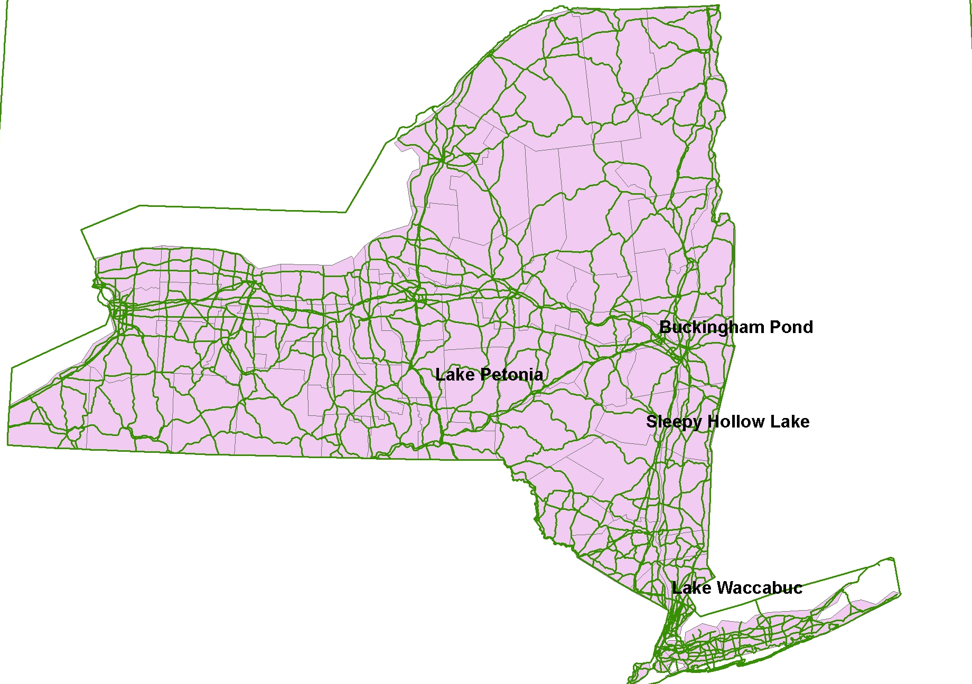
Lakes in the Pilot Test
Notes:
Lake Petonia in Chenango, Buckingham Pond in Albany, Sleepy Hollow Lake in Greene, Lake Waccabuc in Westchester.

Slide 9
38* thanks to 2013 samplers
Laurel Mann, Sleepy Hollow Lake (Greene Co)
Jan Andersen, Lake Waccabuc (Westchester)
Harry Ermides, Buckingham Pond (Albany)
Bruce & Judi Myers, Lake Petonia (Chenango)
* One per sample
Notes:
The DEC and Cornell thank Laurel, Jan, Harry, Bruce and Judi and their friends I haven’t kept track of for being the field part of the team. Volunteer water monitoring is both valuable and fun. I will be doing it after I retire.
These expert, distinguished, highly motivated, and completely unpaid samplers went out in bad weather (or after bad weather) in their boats to fill bottles in selected parts of their lakes at selected depths.
Rainstorms and sometimes snowmelt events are when pesticides get washed out of land and into streams and lakes. Concentrations are higher from the storms particularly in farming areas where a large fraction of land in a lake’s watershed has been treated with the same chemical around the same time – then if it rains soon after.
As an aside, next Saturday at this time I hope to be out in a muddy field at Cornell taking runoff samples to test for a super popular weed killer called glyphosate (trade name Roundup). Our bioenergy test field will be sprayed on Thursday or Friday and we have scheduled a large thunderstorm for Saturday. I know how we schedule the spraying, but I am not sure how we schedule the thunderstorm.

Slide 10
Pesticides tested for at DEC lab
38 pesticides including herbicides. Some agricultural, some urban.
13 compounds that are created when microbes and chemistry digest the originals (“metabolites”)
Glyphosate, atrazine, metolachlor, 2,4-D, some of the most popular in NY and world.
Notes:
The small DEC pesticide lab is outstanding. Their people Pete and Christine are truly expert about telling the different chemicals apart and also at giving us reliable concentrations.
Their main job seems to be law enforcement. Sell something not labeled to be used in New York, spend some time in jail. Pete and Christine have to figure out what the heck that stuff was that sent 20 kids to a hospital. Environmental water samples wait while enforcement takes priority.
We are sorry to our samplers that it took two years for our samples to come up in the queue. They are frozen the whole time and we know this preserves them very well.

Slide 11
Results: About concentrations
Parts per billion (micrograms per liter) are 1000x smaller than your familiar milligrams per liter (parts per million).
Some labs getting so precise that they can find a few parts per trillion (nanograms per liter).
Some pesticides can have human or ecological effects at the low parts per billion level.
Notes:
Yesterday’s “not detected” is todays “detected at low level”. Conditions are not getting worse, the microscope is getting closer.

Slide 12
Results: About detection limits
Quantified detection. Number provided.
Quantification limit
Concentration in parts per billion (ppb)
Trace level. Not reliably quantifiable
But good confidence a specific chemical is there
Detection limit
Not detected, lost in the noise
or actually nothing there
zero
Notes:
I’m sure you are very familiar with phosphorus and nitrogen numbers from your lake ecology tests.
You get a number from nearly every sample. Maybe not for nitrogen in the summer.
In pesticides we do not get any numbers for most of the tests. They are not zeroes, they are “not detected” to the limits of the machines and their operators.
From true zero up to something called a “detection limit”, the lab reports “not detected.”
Then in some labs (not DEC’s) there is another non-number result above the detection limit and below another threshold, a quantification limit. In this range, the lab will tell you that your chemical is likely there but they can’t tell you its concentration. This is called a “trace”. DEC’s lab gives us numbers all the way down to their detection limit so there is no “trace” zone. I will use this term “trace” to apply to the very low numbers.
Phosphorus testing works the same way but you will rarely see any “not detected” results.

Slide 13
2013 Results: Synopsis
Not detected to a detection limit around 0.1 parts per billion for most original chemicals in all lakes. A few detection exceptions.
No concentration of known health significance.
GOOD. But beware of DOH warning about pathogens in unfiltered surface supplies.

Slide 14
Results exception 1: Tebuconazole at Waccabuc
Fungicide used on turfgrass. Golf course?
Somewhat mobile and persistent in environment.
Tiny trace amounts, between 0.01 ppb and 0.1 ppb.
Notes:
Thanks again to Jan.
Sorry if I am pronouncing this wrong. The product names are easier to pronounce but we must be generic.
This is the only one of 51 chemicals detected at Lake Waccabuc.
Most of the non-detections are because the chemical was never used in the watershed and doesn’t move in the atmosphere. We test every sample for all 51 to simplify things for the lab.
There could be many reasons why we didn’t detect anything more than this trace of one chemical at Waccabuc. There are thousands of chemicals that could have been used legally, and we look for 38 plus. We are limited in finding the small traces by not using state of the art gear, no elaborate procedures, and not cleaning things with hazardous chemicals. The lab is way ahead of our sample handing process in the ability to find things. That is OK.

Slide 15
Results exception 2: 2,4-D at Buckingham
Weed killer sold over the counter. Very widely used.
Small amounts 0.1-0.2 ppb.
Very surprised that there were not more chemicals detected given the urban setting.
Notes:
Is Harry here?
This is our most urban lake. I was quite surprised that we didn’t pick up more traces or above. In this one too I think we are limited by the list of 38 pesticides and/or our sample collection and processing budget.

Slide 16
Atrazine and metolachlor at Sleepy Hollow Lake 1
Agricultural herbicides, restricted, heavy use.
Atrazine drinking water standard is 3 ppb. Concern about cancer, endocrine disruption.
Metolachlor much less concern.

Slide 17
Atrazine and metolachlor at Sleepy Hollow Lake 2
Atrazine in the 0.2-0.5 range many samples. Metolachlor up to 0.2 in fewer samples.
Agricultural watershed.
Also found in wells other upstate areas. Half of 40 private wells we tested in Cortland county contained atrazine traces.
Notes:
Good work Laurel!
Could you take a moment to mention the weather and lake conditions when you sampled? Two years ago, sorry.
It is the high flow conditions that wash pesticides out of soil and into streams and lakes.

Slide 18
Atrazine and metolachlor at Sleepy Hollow Lake 3
Environmental breakdown products of atrazine and metolachlor in more samples than original chemicals at levels 0.025-0.1.
Again they had to torture the lab machines to get better sensitivity than usual 0.1.
This is also extremely common upstate.

Slide 19
Recap of results
Unsurprisingly clean Petonia.
Surprisingly clean urban Buckingham.
Waccabuc also quite clean, just one chemical of slight interest.
Sleepy Hollow agricultural residues at typical levels, well below drinking water standards.
Notes:
Judi and Bruce’s samples at Petonia yielded all non-detects. Doesn’t seem to be much agriculture, not an urban area though a lot of houses packed around the lake.
For Buckingham and Waccabuc I think we are limited by a narrow list of chemicals.
For Sleepy Hollow our list had the right chemicals (though there certainly could be more) and we repeat many earlier test results across New York: the agricultural herbicides are out there at concentrations below current standards.
A friend who studied atrazine in water decided that he didn’t want his family drinking water at 0.3 ppb of atrazine. He was getting his own water from a lake he studied, through a public water system. This level would not trigger any treatment requirement by the water supplier. It is possible to treat water to remove atrazine, so he spent the money.

Slide 20
Next
Interim report for review by volunteers and two DEC divisions.
Another round? Same lakes?
Different chemical list, more modern, more customized to a lake.
Notes:
Question for Jan, Laurel, Harry, Judi, Bruce: Was it a burden to collect these samples? You must enjoy being out on your lakes and making a contribution, but this was not at good times to enjoy boating.
We have actually asked for lab capacity to test 20-30 more lake samples this year. However we are late getting started because we wanted to see the 2013 test results.
In any case I will be preparing a draft project report for review by our samplers and the two DEC divisions in June or July.

Slide 21
Questions?

Slide 22
Thanks to, besides samplers thanked earlier
Funding NYS DEC
DEC Division of Water: Scott Kishbaugh
Laboratory Analysis: DEC Division of Air, Pete Furdyna and Christine VanPatten
Cornell project leads: Tammo Steenhuis and Brian Richards.
DEC Pest Management Bureau Staff: Luanne Whitbeck (retired), Jason Pelton, Scott Menrath
Dean Long who I think is behind this.
Notes:
22
22
22
Questions?

Slide 23
Thank You!

Slide 24
Contacts
Steve Pacenka (sp17@cornell.edu)
Tammo Steenhuis (tss1@cornell.edu)
Jason Pelton (jason.pelton@dec.ny.gov)
Scott Kishbaugh
http://soilandwater.bee.cornell.edu/Research/pesticides/‏
Notes:
24
24
24
Please feel free to contact us for more details.
Our website, and that of the Pesticide Sales and Use reporting system, contain downloadable data and reports.

