Slide 1
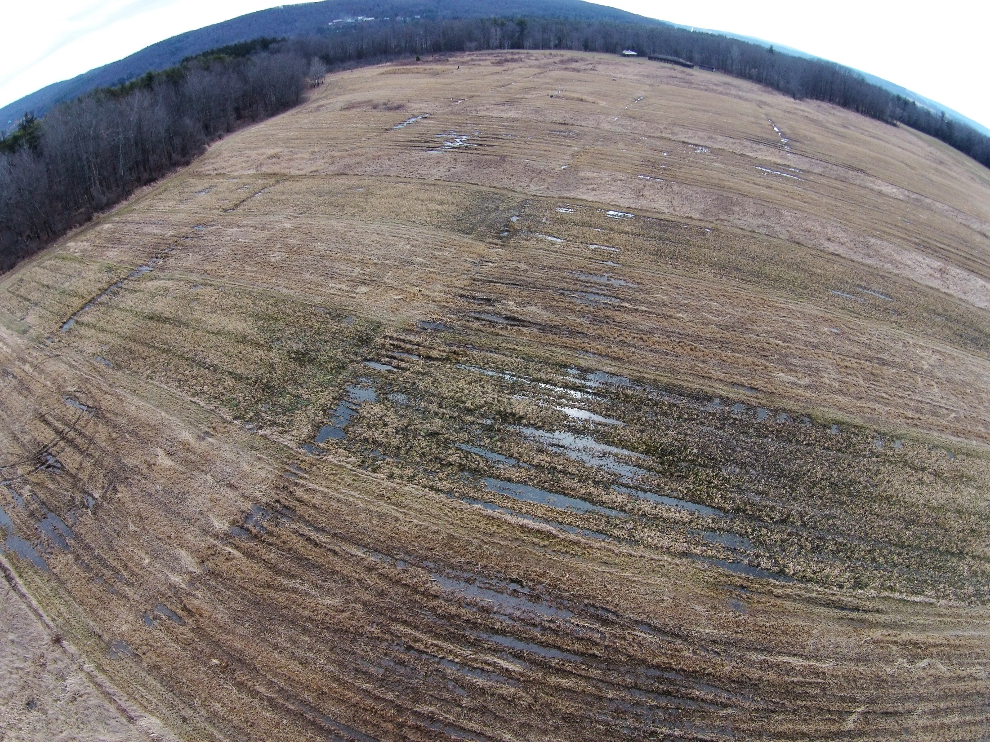
Runoff quality and other side effects of an experimental biofuel grass site on economically marginal land
Emma Payne, Steve Pacenka
(Principal investigators Brian Richards and Tammo Steenhuis)
For Soil and Water Seminar, Nov 2020
Notes:
Thanks for the chance to reconnect the two subsets of the soil and water lab.
Emma and I are one quarter of the Tammo and Brian faction. Essentially all of us are working on the site that Emma and I will review today, and we also work on other locales and subjects, spanning from the microscale of how water flows between unsaturated sand grains to the future of irrigated agriculture in the North China Plain.
Brian and Tammo are the leads for this activity, and Emma and I are humble data collectors and interpreters.

Slide 2
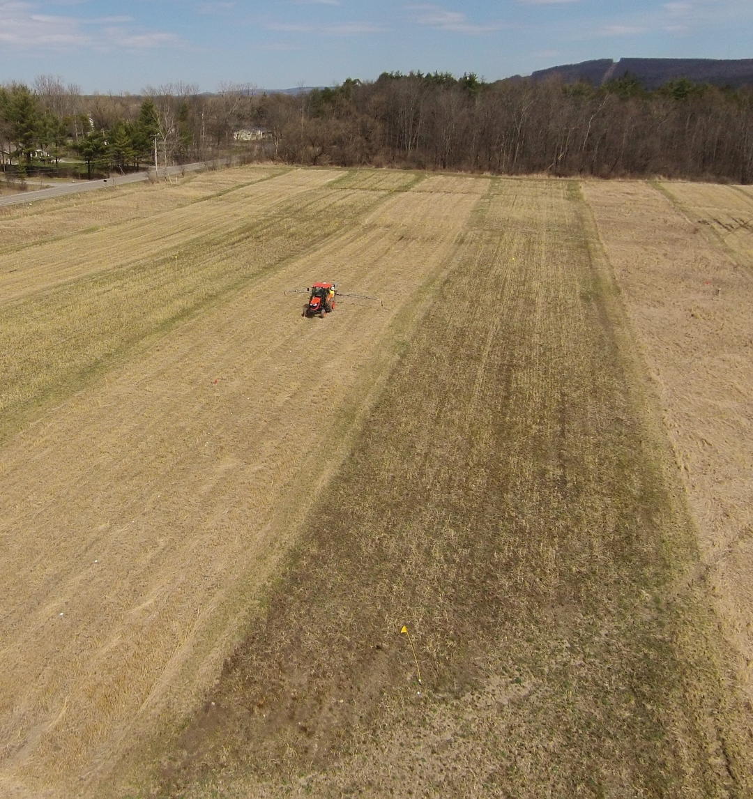
Outline
Site objectives and background (Pacenka)
Data collection (Pacenka)
Glyphosate in runoff (Emma)
Chloride and conductance in runoff (Emma)
Next (Pacenka)
Questions?
Notes:
Today we shall Zoom through four sections about past and present, and one about future.
I will give background, Emma will cover our water quality results, and I will give a closure and we can field questions. Emma and I have worked together for over two years on the site so it was a natural that when Todd asked me to present I immediately recruited key student Emma.

Slide 3
Outline
Site objectives and background (Pacenka)
Data collection (Pacenka)
Glyphosate in runoff (Emma)
Chloride and conductance in runoff (Emma)
Next (Pacenka)
Questions?

Slide 4
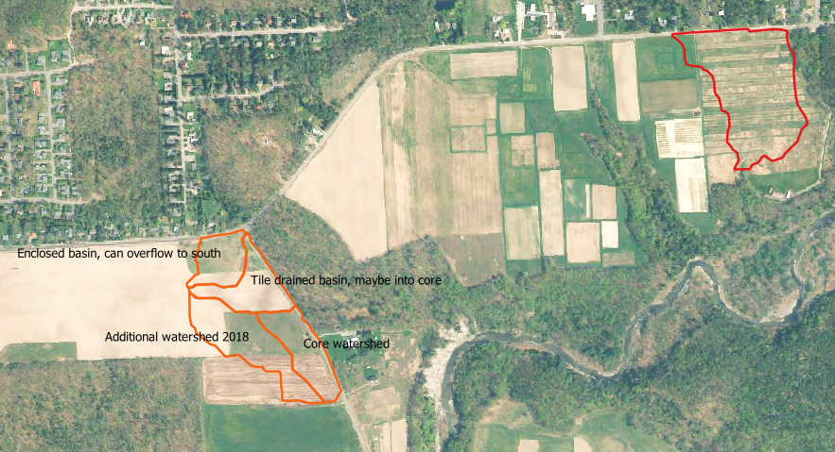
Glyphosate research sites 2020
CRC (S1) site
Freese Road (S5) site
Notes:
We have two water quality sites this year, the Cornell Recreation Connection (CRC) on Hanshaw Road across from where Liz and Wade live, and a site along Freese Road across from where the bees live at the Dyce lab. Both drain to Fall Creek and send water and herbicides past Cornell’s water supply intake.

Slide 5
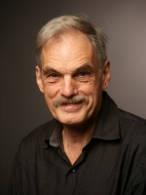
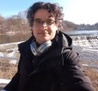
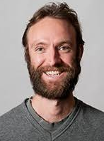
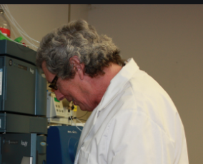
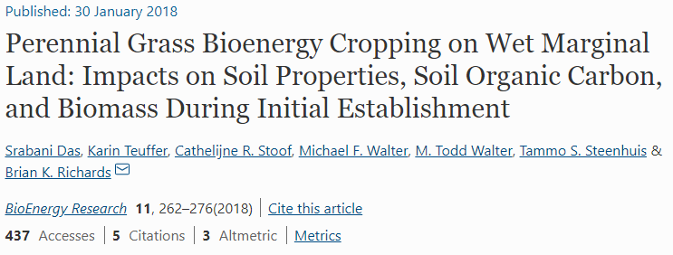
Eclectic research on abandoned farmland …
Greenhouse gas emissions | Grass yield on marginal land | Soil health changes | Glyphosate in runoff
Self organizing hydrology in shallow soils (pending)
(Naaran and Tammo)
Using a road salt plume to understand water and glyphosate and flux (pending)
(Emma)
Notes:
Our objectives today are to provide some background about the CRC site and to review how an annual spring spraying of glyphosate results in loss in runoff. Brian Richards and Tammo Steenhuis are the research leads, particularly Brian who has coached a variety of PhD students whose thesis work revolved around the site.
The site was established to study the environmental effects of growing biofuel grasses on economically marginal farmland.
The people pictures are Brian who provides the benevolent leadership of all. Cedric Mason former PhD student, Julie Hansen key collaborator in the crop (Cornell plant breeding faculty), Srabani Das former PhD student, and Mike Meyer collaborator in US Geological Survey. There have been many other people involved, sorry not to mention everyone.
I am research support staff to Tammo and Brian; I take most responsibility for water quality and water flow and storage measurements in particular the data quality. Emma has been involved for three years in the field and laboratory work and is doing an honors thesis this year. Maybe that sixth box at left will have a paper in it. We also have a post doc Naaran involved now, and two other undergrads Cara Smith and Kayleigh Furth.
The land was fallow for decades before Brian’s initial project took it over in 2011. It was growing weeds because it was uneconomic to grow anything profitable. But maybe in these times there is a new crop – biofuel grasses.
The biofuel perennial grasses, especially Liberty Switchgrass, do well with the help of Cornell Farm Services who manages to get the machines out there for fertilizing, herbicide spraying, and harvesting. We were just out there on Tuesday and Wednesday to harvest the 2020 crop.
The site has yielded publications about greenhouse gas emissions, soil health evolution (particularly carbon accumulation), yield of different varieties, and most recently glyphosate herbicide residues in runoff. We spray portions of the site each year in the spring to kill off competing cool season weeds.
The Cornell Recreation Connection field site, CRC, has been a productive location for a variety of research since Brian Richards established it in 2011. Brian and Tammo are the scientific leads. I am research support staff to Tammo and effectively to Brian.
This is just to illustrate the very varied research that has gone on at the site. Emma and I are only presenting about the glyphosate work which is most recent.
The site grows biofuel grasses. The soil has a restrictive layer at around the order of 1 meter down which makes it prone to seasonal wetness – standing water and runoff. That made it uneconomic to grow conventional crops because of difficulty to farm machines, but we seem to be able to grow the biofuel grasses well enough. Some are very good at surviving transient waterlogging.

Slide 6
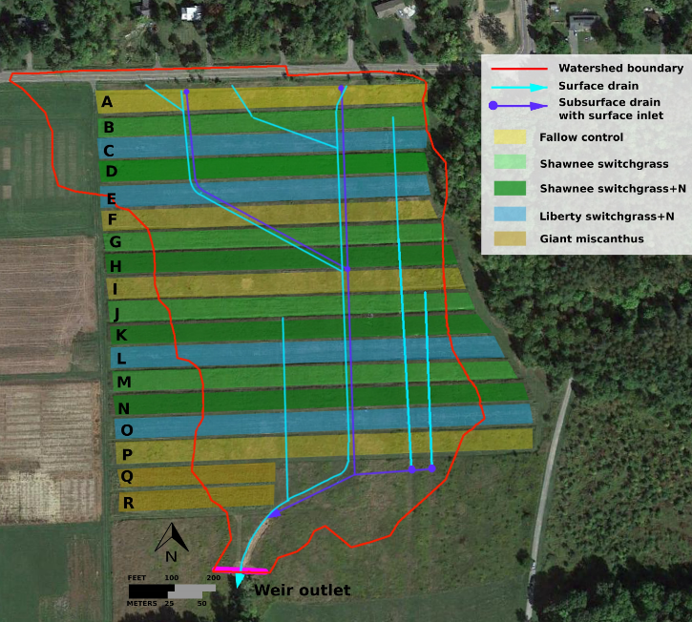
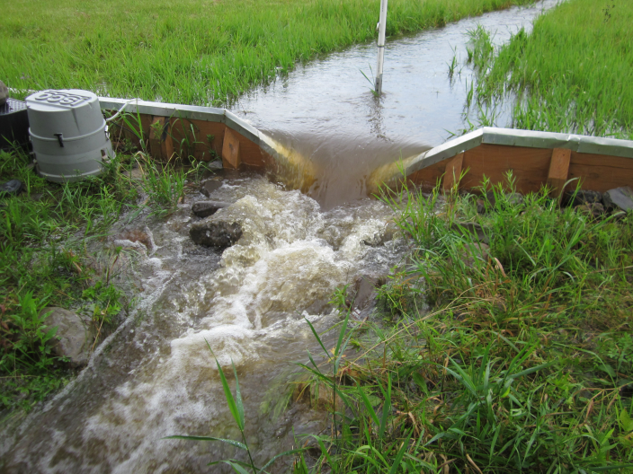
Notes:
The CRC site has eighteen plots with three different crops and one variant of a crop that omits fertilizer. This is on the order of 10 hectares The delineated watershed, which flows from north to south, is around 7 hectares.
We have some surface drainage swales and tile drains that assist water from draining from the site. Water tends to pond in wet periods. The runoff mechanism is that first you first fill the soil, then your local ponded water has to overcome the microtopography. If the storm provides enough water beyond what was already there, we receive flow at our southmost point, where we have a V-notch weir.

Slide 7
Outline
Site objectives and background (Pacenka)
Data collection (Pacenka)
Glyphosate in runoff (Emma)
Chloride and conductance in runoff (Emma)
Next (Pacenka)
Questions?

Slide 8
Now: measurement with decentralized and internet logging technology
Water level behind
weir to compute outflow
Piezometer
water levels (5-7)
Paired soil moisture sensors (0-3)
Onsite meteorology
Live Internet
Logger
Live Internet (1)
Loggers (4-6)
Future Live Internet
Loggers
(0-3)
Live Internet
Cornell and amateur weather stations
Manual laptop downloads USB
(1-6 month lag)
Web downloads & scrapes
Cross-checking
(6-12 month lag)
Ad hoc
cumulative database
Glyphosate escape loading
Annual and event hydrological modeling
Notes:
We have accumulated quite a bit of time series data collection about water flow and storage. We try to account for as much as possible of the water cycle, excepting evaporation which was not originally important to the greenhouse gas work.
Most important measurement is at the exit weir, which is also where we take water samples for glyphosate. We measure water levels every 5 minutes and calculate the flow over the V-notch weir. Those data are not available until we download them. I really wanted to see what was happening on the site in real time, so in spring 2019 I worked with some students in Sunny’s 4500 class to recycle some abandoned Tru-Track water level sensors into composite devices that transmitted water levels to internet in real time. That has been really helpful to help us decide when to activate our autosampler at the weir.
There is also quite a bit of spatial variability in short term (on the order of one hour) rainfall. So this year we put out an amateur weather station on the site. It reports to Weather Underground every 5 minutes or so.
We also measure water levels in piezometers. There are 60 piezometers out there and we intend to have recorders in 6 of them. Four of them are operating now, two have dead batteries that I am trying to replace. I added an internet reporting level sensor in fall 2019 which has been reporting every half hour since then.
We were measuring soil moisture. That has been problematic and is mostly suspended. We are ready to redeploy two pairs of sensors, one of the pairs transmitting to internet in real time.
[Managing this stream of data has been a major problem. The original weather station at the site recorded everything ten times per second because of the need to quantify 3-dimensional wind vectors. All of the standalone loggers have to be read, and if you download four months later you may find that something failed after your last download so you have nothing for the last period. That is the second thing that motivated me to want some data to be in real time on internet, the long time until failures became visible.]

Slide 9
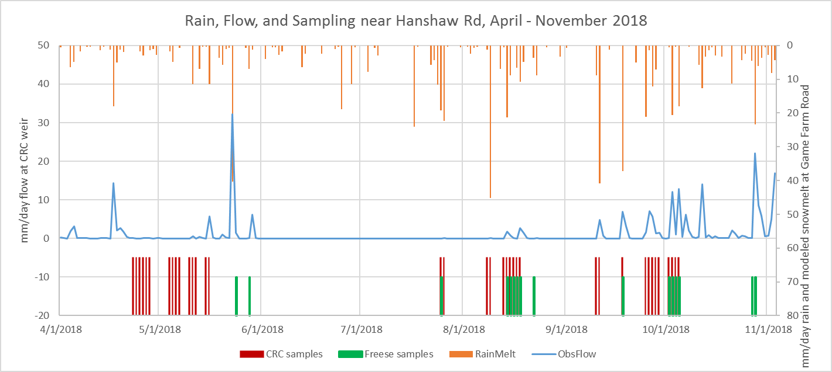
Example timing of autosampling, 2018
CRC sprayed 4/23
Freese GMO sprayed 6/21
Notes:
We use actual rainfall from offsite (until recently), actual flow, and weather forecasts to decide when to activate our autosamplers.
We sample for glyphosate in the first storms after spraying in spring. That uses 1-hour to four-hour compositing intervals.
We have done sampling campaigns every spring starting in 2015, and a second in 2016 fall because we were spraying during the summer to be able to change crops on four plots without plowing under the prior crop.
The 2018 spring sampling season lasted into early October. That was one one long campaign ☺ The other campaigns tended to stop in 2-4 weeks.
There are now seven campaign data sets where we know when and where the glyphosate was sprayed, have an increasingly thorough and cleaned up idea of time series hydrology, and time series sampling results for glyphosate. Last year we began also to look at chloride and specific conductance more. Cheap to analyze, do them in your bedroom or kitchen, or while onsite. Who needs a lab?

Slide 10
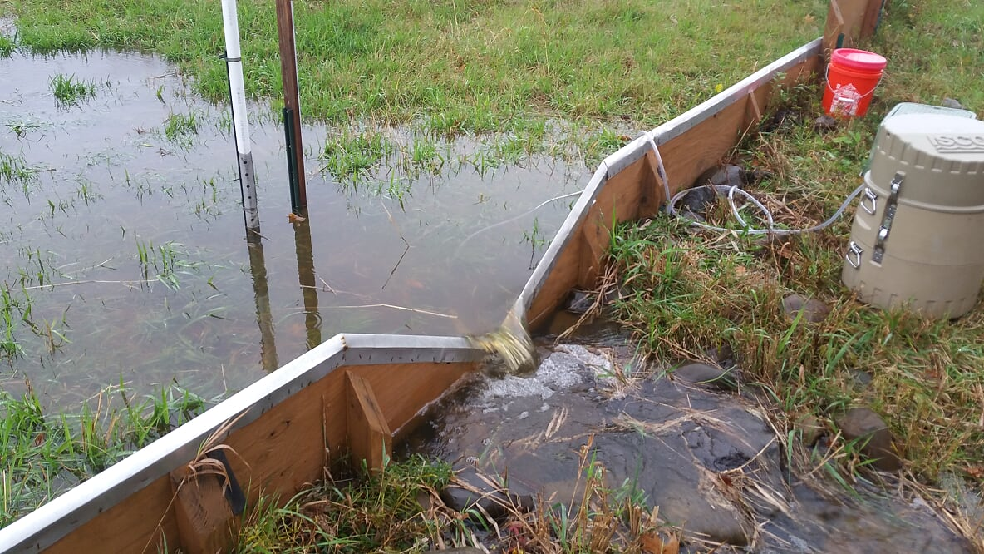
Weir's water level logger
Weir
Autosampler
Notes:
The autosampler and the weir water level logger work together to tell us how many grams per hour are exiting our field. Flow in liters per second X micrograms per liter = micrograms per second flux.
We rebuilt this weir last year because it has been rising out of the ground, and tilting.
I will now hand over to Emma who will present the glyphosate then chloride and specific conductance time pattern data primarily from this location.
Then I will pick up with what is next, and we can entertain questions.

Slide 11
Outline
Site objectives and background (Pacenka)
Data collection (Pacenka)
Glyphosate in runoff (Emma)
Chloride and conductance in runoff (Emma)
Next (Pacenka)
Questions?

Slide 12
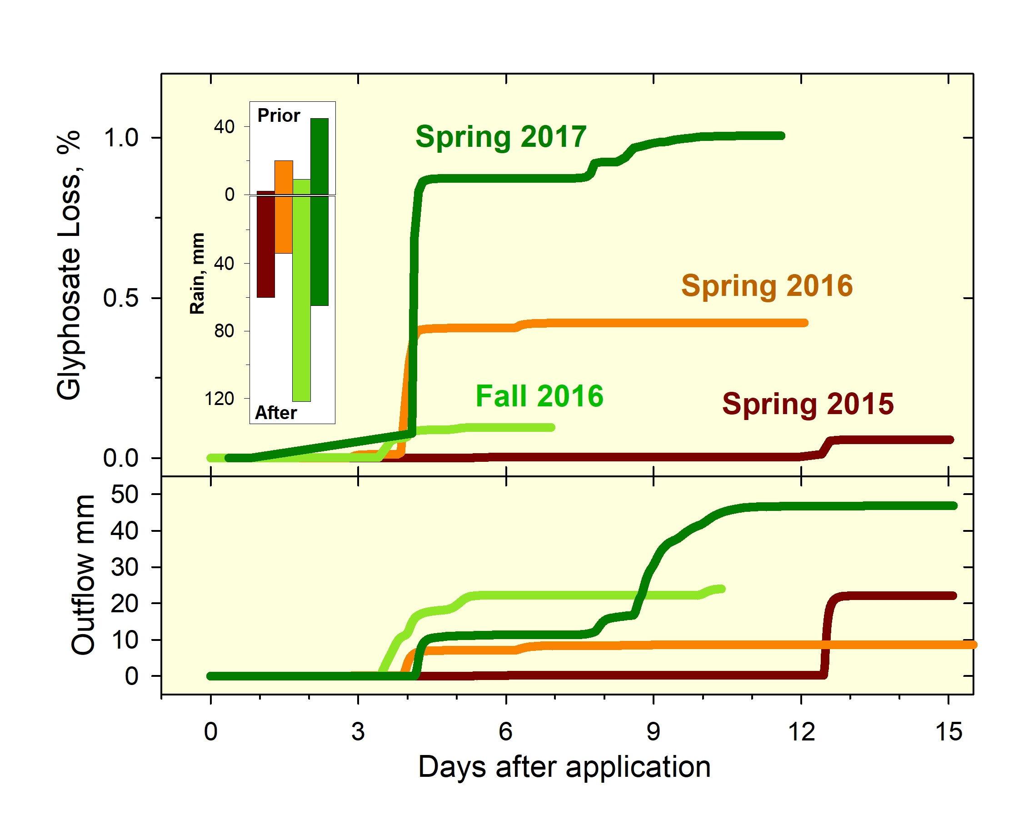
Previous Findings
Cumulative efflux 0.1-1%
Timing of increases in efflux correlated with timing of large flow events
Richards, B. K., Pacenka, S.,Meyer, M. T., Dietze, J. E., Schatz, A. L., Teuffer, K., Aristilde, L, & Steenhuis, T. S. (2018). Antecedent and Post-Application Rain Events Trigger Glyphosate Transport from Runoff-Prone Soils. Environmental Science & Technology Letters, 5(5), 249-254

Slide 13
2015-2017 results indicate correlation between antecedent moisture and efflux

Slide 14
But 2018-2020 results complicate that picture

Slide 15
New Task: Improve our hydrological understanding of the site in order to determine mechanism of glyphosate loss

Slide 16
Outline
Site objectives and background (Pacenka)
Data collection (Pacenka)
Glyphosate in runoff (Emma)
Chloride and conductance in runoff (Emma)
Next (Pacenka)
Questions?

Slide 17
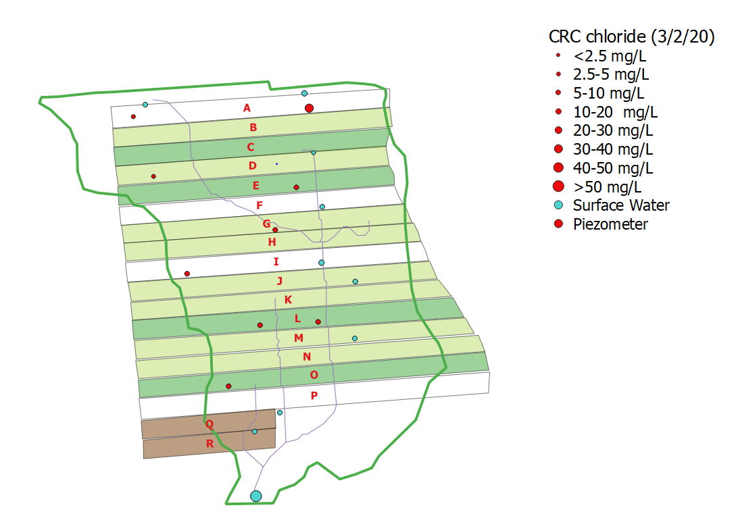
Chloride is introduced to watershed as point source from de-icer salt
Hanshaw Rd.
Weir
Notes:
Contrary to glyphosate, chloride (and conductance) doesn’t degrade or sorb to soil so comparing chloride flux to glyphosate flux can illuminate the mechanisms by which glyphosate travels in water

Slide 18
1. Conductance (and chloride) is diluted during storms
Notes:
Conductance and chloride are diluted by increasing flow during storms. Because chloride doesn’t sorb to soil particles it can infiltrate and travel through the subsurface. Therefore chloride is supplied to the weir via the baseflow.

Slide 19
2. Chloride fluctuates during low flow as flow paths dry out
Notes:
Conductance and chloride map one to one during storms. During storms the whole field is contributing to the flow and chloride makes up a consistent part of all ions. During low flow macropore flow paths dry out and only certain areas of the field contribute to the flow. Because conductance is everywhere in the field conductance is steady but because chloride comes only from the road it fluctuates during low flow

Slide 20
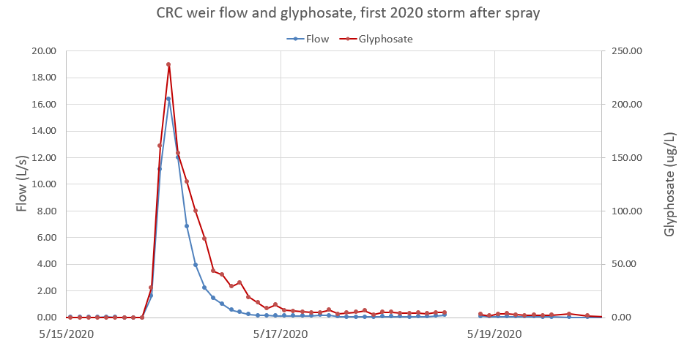
3. Glyphosate conc. increases during storms
Notes:
Glyphosate travels in the surface flow and as the flow increases more and more glyphosate is mobilized

Slide 21
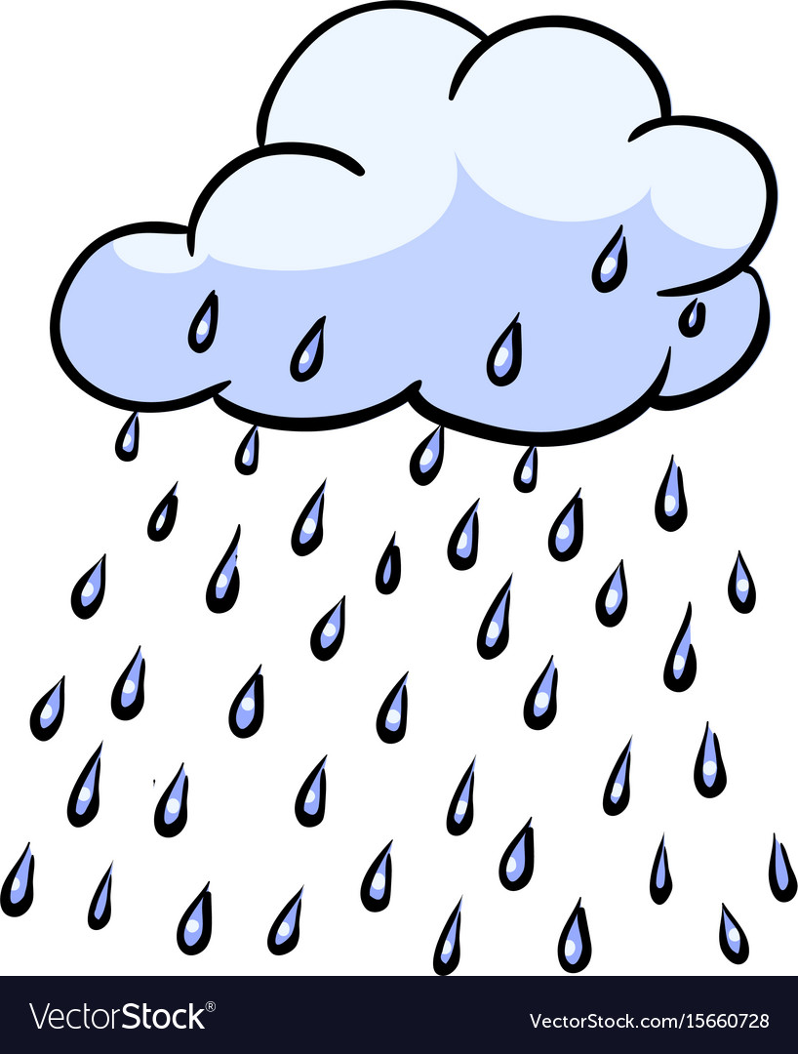
Hanshaw Road
Series of connected reservoir model
-slow moving baseflow component
-rapid storm surface flow component
These results led to formulating a mental model

Slide 22
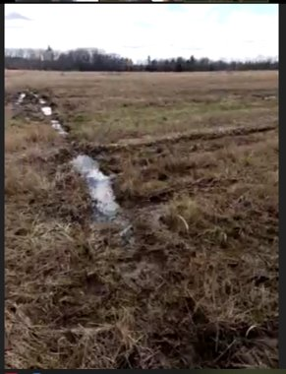
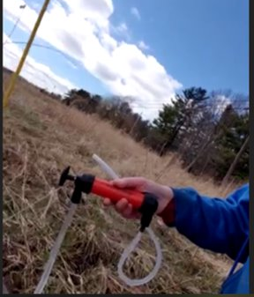
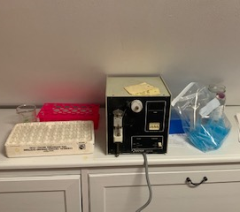
Takeaway: Monitoring chloride and conductance is an easy and cheap way to improve hydrological understanding of the site
Samples from ponded water
Zoom field work session
COVID home lab set up

Slide 23
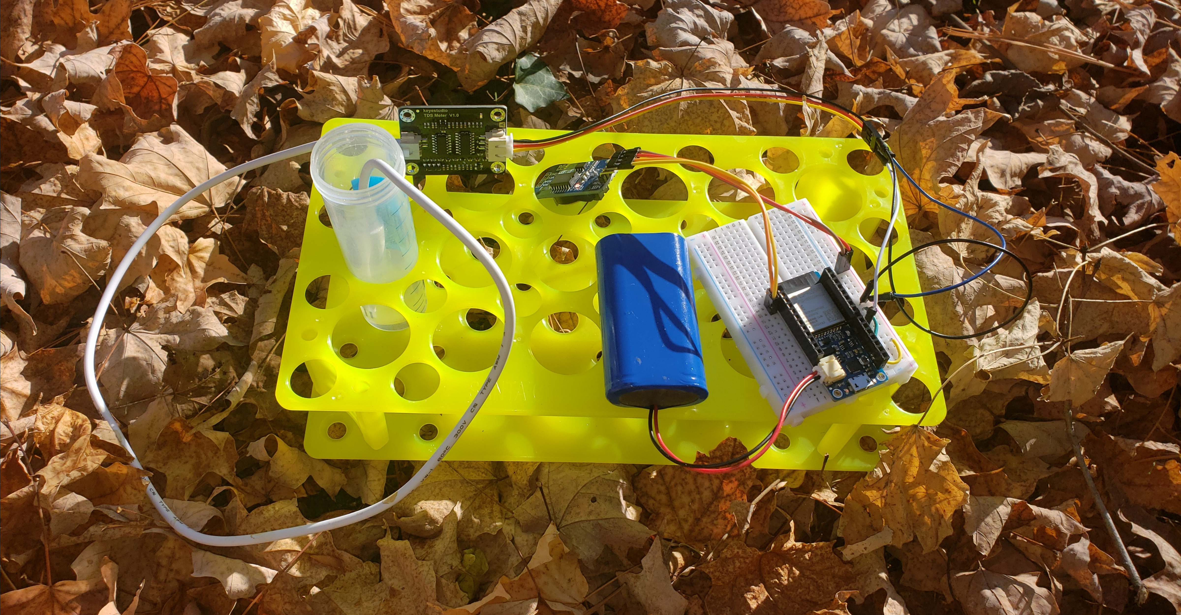
Conductance can be measured continuously in field, maybe ...
Battery-backed clock
ESP32
microcontroller
with wifi,
programmed in Python,
transmitting to Internet
Probe
“Piezometer”
Lithium-ion battery

Slide 24
Outline
Site objectives and background (Pacenka)
Data collection (Pacenka)
Glyphosate in runoff (Emma)
Chloride and conductance in runoff (Emma)
Next (Pacenka)
Questions?

Slide 25
Next
(Just completed: 2020 harvest)
Journal paper: self organizing hydrology (Naaran and Tammo)
Journal paper: chloride and specific conductance as tracers to help understand glyphosate movement (Emma)
Journal paper: glyphosate transport modeling (Naaran, Tammo, and Brian?)
Internet transmissions of specific conductance, soil moisture, and soil moisture tension

Slide 26
Thanks to
Funding: USDA, NYS DEC, Atkinson Center
Cornell Principals: Brian Richards, Tammo Steenhuis
Federal Analytical Cooperators: US Geological Survey, Organic Geochemistry Research Lab, Kansas: Mike Meyer, Julie Dietze
NYSDEC Analytical Cooperators: Pete Furdyna, Christine Van Patten
Cornell Cooperators, Plant Breeding: Julie Hansen, Ryan Crawford, Jamie Crawford
Cornell field operations: Timothy Dodge, William Huizinga, Robert Deubler, Gene Sczepanski
Cornell Analytical Cooperators, BEE: Ludmilla Aristilde, Matthew Kukurugya, Fanny Okaikue-Woodi, Zoe Maisel, Reid Balkind
Cornell students: Emma Payne, Cara Smith, Kayleigh Furth, Benjamin Lee, Christian Guzman, Tigist Tebebu, Haimanote Bayabil, Abeyou Wale, Karin Teuffer, Luam Azmera, Bahareh Hassanpour, Dessalegn Dagnew, Adugnaw Akale, Fasikaw Zimale, Zain Z. Azziano (visitor), Cedric W. Mason, Roger Serrano (visitor)
Cornell BEE staff: Cathelijne Stoof, Steve Pacenka, Ani Schatz, Naaran Brindt, Shree Giri

